Slide 1
1. Acute diseases of larynx
Department of Ear, Throat and Nose Diseases
Sechenov University
Moscow, Russia

Slide 2
Laryngeal disease can be both independent and a symptom of the pathology of other organs and systems of the body

Slide 3
The structure of inflammatory diseases of the larynx
Acute laryngitis (catarrhal, submucous or edematous-catarrhal, phlegmonous)
Chronic laryngitis (catarrhal, atrophic, hyperplastic)
Specific laryngitis (tuberculous, syphilitic, chlamydial)
Secondary laryngitis (reflux laryngitis, amyloidosis of the larynx, laryngitis with lymphoproliferative diseases)

Slide 4
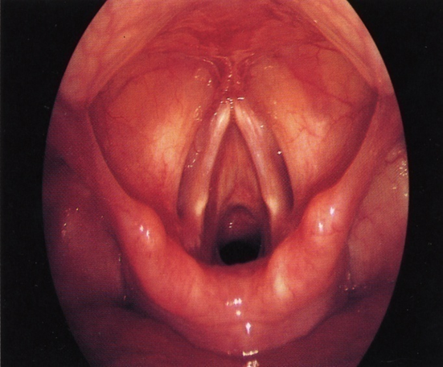
Acute catarrhal laryngitis
Предрасполагающие факторы
общее и местное переохлаждение
чрезмерные голосовые нагрузки
вирусные инфекции
контакт с раздражающими веществами
очаги гнойной инфекции дыхательных путей
длительное ротовое дыхание

Slide 5
The clinical picture:
voice change - hoarseness (dysphonia), up to the complete disappearance of the voice (aphonia);
burning sensation, sore, foreign body in the throat;
dry unproductive cough
Notes:
При ларингоскопии: гиперемия и отек всех отделов гортани, особенно выраженные на голосовых складках. Острый ларингит дифференцируют с обострением хронического ларингита, узелками голосовых складок, функциональной дисфонией, парезом голосовых складок, доброкачественными и злокачественными новообразованиями.

Slide 6
Treatment of acute catarrhal laryngitis
Voice mode (silence)
Diet: the exclusion of spicy, sour, salty and hot foods,
Exclusion of bad habits: alcohol, smoking
Antiviral treatment
NSAIDs for intoxication
Inhalations (steam, alkaline)
Antihistamines, with a burdened allergic history
Aerosol forms of antiseptics and antibiotics

Slide 7
Acute lamellar laryngitis (false croup)
The main cause of the disease is SARS, parainfluenza, a combination of various respiratory viruses
Predisposing factors:
Constitutional anomalies
Hypertrophy and chronic inflammation of the elements of the lymphadenoid pharyngeal ring
A burdened allergic history

Slide 8
Clinical picture
An acute onset, in the form of an asthma attack, mainly at night, often in the supine position
Respiratory dyspnea, stridor breathing, restless behavior
Barking cough, sometimes interrupted by laryngospasms
Acrocyanosis, participation in the act of breathing of auxiliary muscles
Endolaryngial picture: red ridges protruding under the vocal folds
Possible relapse of seizures

Slide 9
Anatomical and physiological prerequisites for the development of spinal laryngitis in children
The softness of the cartilage skeleton
short and narrow vestibule of the larynx
high location of the vocal cords
cell-rich mucosa
friable, profusely blood-shed submucosa with a large number of mast cells
increased reflex excitability of adductor muscles that close the glottis,
widespread and functional immaturity of reflexogenic zones of the larynx

Slide 10
Differential diagnosis of sub-laryngitis laryngitis
Acute stenosing laryngotracheitis
Foreign body of the respiratory tract
Pharyngeal abscess
Laryngeal diphtheria (false croup)
Epiglottis abscess

Slide 11
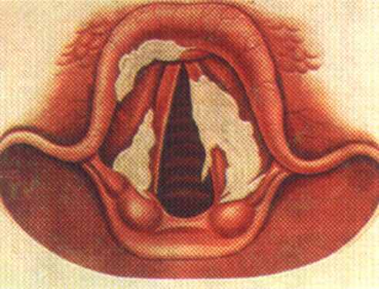
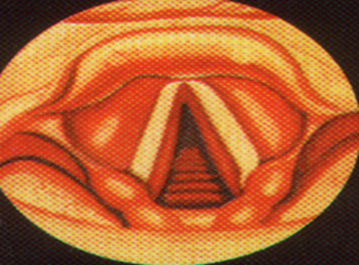
Differential diagnosis
subluminal laryngitis
subluminal laryngitis
Diphteria of larynx

Slide 12
Sign | False croup | True croup
beginning | Sharp at night | Gradual respiratory depression
Voice | Sonorous | Hoarseness to aphonia
Cough | Barking | Loud at the beginning, gradually turning into soundless
Lymphadenitis | No | cervical
Fibrinous plaque | No | On tonsils, in the larynx
Intoxication | Expressed against the background of ARVI | Weakly expressed, gradually increasing

Slide 13
FIRST AID:
pick up the baby and calm
place the child in a room with warm, moist air
give a drink with a spoonful of warm water or milk
hot foot baths
antihistamines
to stop laryngospasm cause a gag reflex
hormone inhalation through a compression nebulizer
MEDICAL HELP:
intravenous administration of corticosteroids (prednisone at a rate of 1-2 mg per kg of child's weight)

Slide 14
HOSPITAL TREATMENT:
humidified oxygen
antihistamines
sedatives
corticosteroids
inhalation therapy
when attaching a secondary infection - antibiotics
with treatment failure - prolonged intubation up to 5 days; with inefficiency - tracheotomy

Slide 15
Acute stenosing laryngotracheitis (OSLT) Infectious-allergic inflammation of the mucous membrane and muscles of the larynx, combined with inflammation of the mucous membrane of the trachea
Usually more frequent in autumn and winter
Most common at the age of 6 months to 4 years
More common in boys
Caused by influenza, parainfluenza, adenovirus and RS - viruses

Slide 16
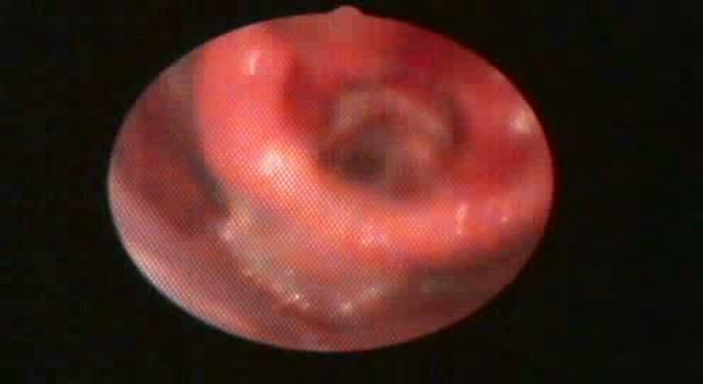
Acute stenotic laryngotracheitis
The clinical picture is the sudden onset of the disease, hyperthermia, symptoms of intoxication, a “barking” cough, accompanied by stenosis of the larynx, up to asphyxiation.
Sechenov University archive, 2018.

Slide 17
Acute stenosing
Laryngotracheitis
Forms
edematous infiltrative
purulent fibrinous
hemorrhagic
necrotic
Palchun V.T., Kryukov A.I. 2010

Slide 18
Pathogenesis
Mucosal edema
larynx and trachea
Hypersecretion of the glands
mucous membrane
larynx, trachea and bronchi
Laryngeal muscle spasm
trachea and bronchi

Slide 19
Treatment of acute stenosing laryngotracheitis
Etiotropic
antiviral
antibacterial
Pathogenetic
anti-inflammatory (NSAIDs)
-dehydration
desensitizing
antitussive
Symptomatic
- antipyretics
- sedatives
- analgesics
With an increase in laryngeal stenosis - intubation
no more than 5 days, with inefficiency - tracheotomy

Slide 20
Acute epiglottitis
A special form of edematous-catarrhal laryngitis with a predominant lesion of the epiglottis
Incidence - year-round
found in both children and adults (more often in men)
caused by H. Influenzae - type B - in children, in adults - pneumococcus, Streptococcus A, meningococcus

Slide 21
Clinical manifestations
Acute onset
Severe general condition, hyperthermia
Respiratory dyspnea and stridor
Severe sore throat
Dysphagia
Hypersalivation
Orthopnea
Muffled or choked voice

Slide 22
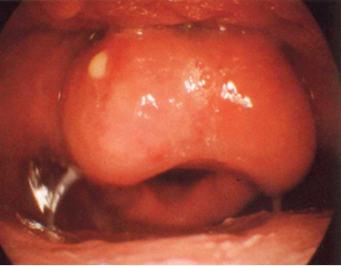
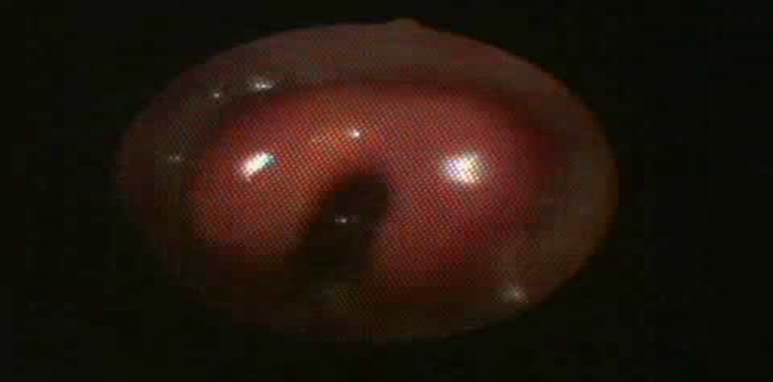
FORMS OF EPIGLOTTITIS:
Edematous
Infiltrative
Abscess
Department of Diseases of the Ear of the Throat and Nose of Sechenov University, 2018 Endoscopy Archive
Notes:
Острый эпиглоттит дифференцируют с язычной ангиной, заглоточным абсцессом, острым стенозирующим ларинготрахеобронхитом, подскладочным ларингитом, инородным телом, травмой глотки и гортани, аллергическим отеком гортани и другими заболеваниями, приводящими к острому стенозу гортани.Решающее значение для диагностики острого эпиглоттита имеют данные эндоскопии гортани

Slide 23
Acute epiglotitis is differentiated with:
lingual sore throat pharyngeal abscess acute stenosing laryngotracheitis subluminal laryngitis foreign body throat and larynx injury allergic laryngeal edema

Slide 24
Epiglottitis Treatment
Urgent hospitalization
In the infiltrative form, “notches” of the mucous membrane of the epiglottis are made at the site of greatest infiltration.
With an abscessed form of epiglottitis - opening an abscess
Antibiotics of choice - “protected” penicillins or cephalosporins
Corticosteroids
NSAIDs
With decompensated laryngeal stenosis - intubation or tracheotomy

Slide 25
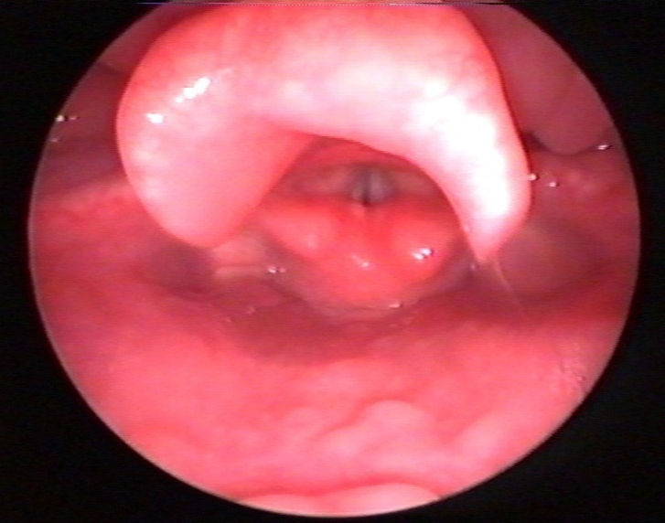
Allergic laryngeal edema
- develops due to sensitization of the body to various allergens
begins acutely, sometimes with lightning speed, against the background of general health, in the absence of catarrhal phenomena, normal body temperature
complaints of severe difficulty breathing, difficulty swallowing, hypersalivation
Кафедра болезней ухо горла и носа
Сеченовского университета

Slide 26
Treatment of allergic laryngeal edema
Allergen Elimination
Antihistamines in oil
IV corticosteroids
Corticosteroid Inhalation
In extreme situations - conicotomy

Slide 27
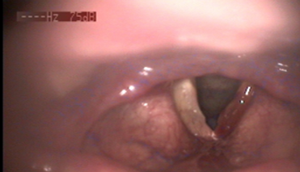
Monochordite
(inflammation of one vocal fold

Slide 28
List of references
Palchun V.T., Kryukov A.I. 2010
Textbooks of the Department of Diseases of the Ear, Throat and Nose of Sechenov University, 1977

