Slide 1

Differential diagnosis of lymphatic system diseases
I.M. Sechenov First Moscow State Medical University
Chair of Surgery No.2

Slide 2
The lymphatic system
        Lymph vessels are a one-way system: there is no central pump, the lymphatics start as minute, blind-ended, endothelial sacs in the intercellular space of all tissues. They transport fluid from the interstitial space via their own vascular system back to the heart.
        Initial capillaries consist of a single row of endothelial cells without a basal membrane, they do not have interluminal valves. Endothelial cells are connected to the surrounding elastic fibers in the extracellular matrix. Their main function is uptake of macromolecules and fluid
        Precollectors consist of endothelial cells surrounded by a basal membrane, have valves that provide lymph flow in one direction
        Collectors consist of a layer of endothelial cells surrounded by a basal membrane, a muscular layer of circular and longitudinal fibers, and adventitia. The muscle layer provides lymphatic peristaltic movement
        Lymphatic vessels transport lymph to the lymph glands

Slide 3
The lymphatic system
The functional unit of the lymphatic vessels is a “lymphangion” – the segment between two valves. It can contract 10-12 times per minute, create a peristaltic movement that pumps lymph fluid towards vessels.

Slide 4
The lymphatic system
Mechanisms providing lymphatic transport:
Intrinsic propulsion of the lymph collectors and lymph vessels
External propulsion by means of tissue movement
Negative intra-thoracic/abdominal pressure, providing a suction pump action on the lymph fluid in thoracic duct

Slide 5
Functions of the Lymphatics
maintaining the interstitial fluid balance and tissue pressure
absorption and transport of macromolecules and lymphatic fluid
immune surveillance

Slide 6
Lymphatic vessels diseases.
Lymphedema.
Lymphedema is an abnormal collection of high-protein fluid in the interstitium. This swelling, or edema, occurs most commonly in the arm or leg.
Any inborn or acquired disruption of lymphatic system will lead to impairment of the lymph transport capacity, which is essential for homeostasis of the interstitium.

Slide 7
Lymphedema
Primary lymphedema: congenital deficit in the numerous of lymphatic vessels, lymph vessels hyperplasia, induration of lymph nodes.
Congenital (since birth)
Praecox (earlu-onset, before
the age of 35 лет)
Tardum (late-onset, after
The age of 35 лет)

Slide 8
Primary lymphedema
Both autosomal dominant and recessive patterns of inheritance have been observed for primary lymphedema, and many single genes and syndromic forms have been described.
Isolated lymphedema, single gene: Milroy disease, Meige, FOXC2 mutation.
Chromosomal disorder: Turner syndrome, Klinefelter syndrome, Trysomy 21, Trysomy 18.
Syndromic lymphedema single gene: lymphedema-distichiasis syndrome, hypotrichosis-lymphedema-telangiectasia syndrome, generalized lymphatic dysplasia.
Dysmorphic/syndromic multifactorial inheritance: Waltmann syndrome, Noonan syndrome, lymphedema hypoparathyroid syndrome, emberger syndrome (primary lymphedema including genital edema, deafness, myelodysplasia).

Slide 9
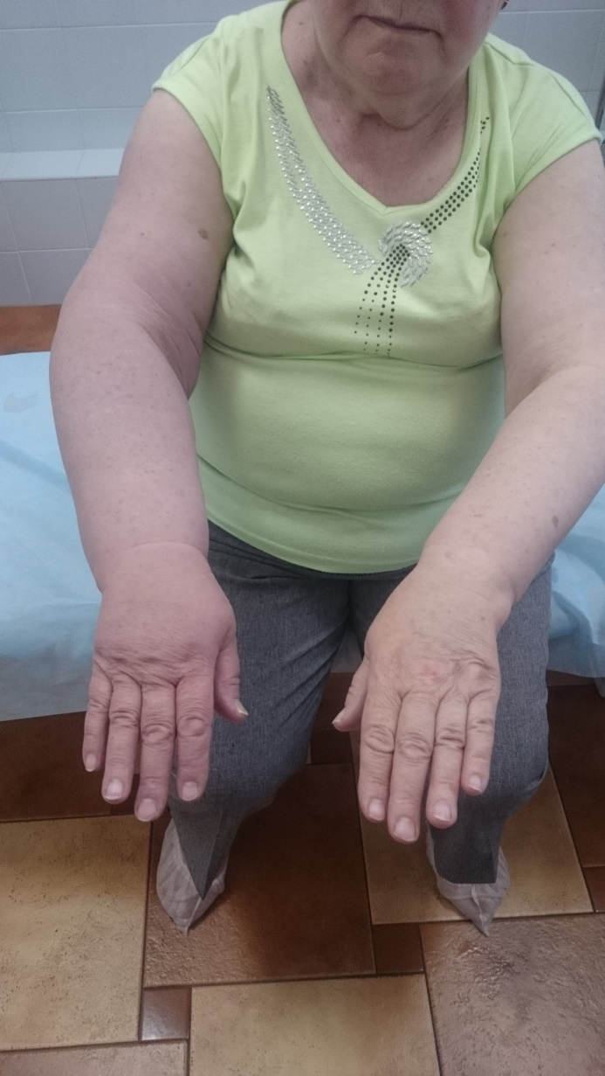
Lymphedema
2. Secondary lymphedema is caused by damage to the lymphatic transport capacity, by infection (erysipelas, filariasis), trauma, surgery, radiotherapy, tumours, metastasis, in morbidly obese patients.
Malignant lymphedema can arise when a malignant tumour compress a lymphatic vessels bundle.

Slide 10
The clinical picture of lymphedema
painless swelling around the basal joints of the fingers or toes
swelling is often unilateral
skin color does not change
at later stages, due to accumulation of interstitial macromolecules inflammatory changes are induced in the subcutaneous tissue, leading to induration and fibrosis
In a few cases the protein does not lead to local induration but is converted into fat

Slide 11
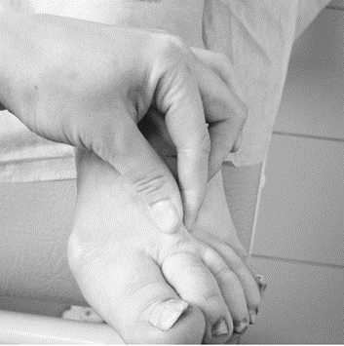
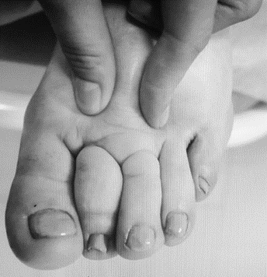
The clinical picture of lymphedema
Stemmer`s sign: enlargement of the skin fold above the second toe due to fibrosis and hypertrophy: so-colled cobble stone toes.

Slide 12
Stages of lymphedema
0 stage: there is some damage to the lymphatic vessels but it has not yet become apparent.
1 stage: oedema appears only towards the evening, the swelling is of soft consistency
2 stage: oedema does not disappear even after prolonged rest, the swelling persists, the skin is hard.
3 stage (elephantiasis): the swelling is associated with complications such as skin lesions with warty outgrowths (papillomatosis), small vesicles (cysts), breaks in the skin through which lymph exudes (fistulae) and definite induration.

Slide 13
The other causes of the lower extremities edema
heart failure
renal failure
hypothyroidism, myxedema
chronic venous insufficiency, acute deep vein thrombosis, postthrombotic disease
injuries and joint diseases
lipoedema

Slide 14
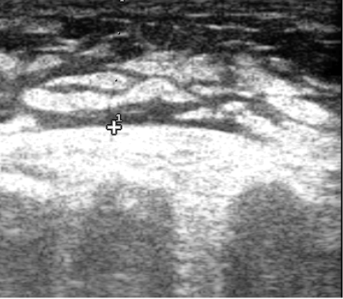
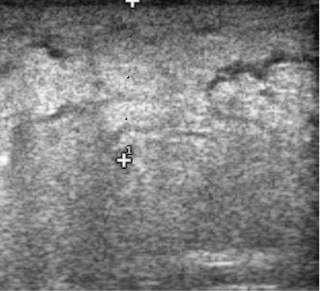
Diagnosis of lymphedema
Anamnesis and clinical assessment are mostly sufficient to diagnose lymphedema. In case of doubt or uncertainty based on lymphatic anatomy or function without clear signs, additional investigations are appropriate.
1. Ultrasound investigations: decisions regarding changes in the skin and subcutaneous tissues can be reached, lymph nodes and vascular changes in the nodes can be evaluated. Useful for differential diagnosis of veins diseases.

Slide 15
Diagnosis of lymphedema
2. Lymphoscintigraphy: is a technique in which 99m Tc-nanocolloid is administered subcutaneously in the skin, and a high-resolution gamma camera allows assessment and visualization of the tracer distribution through the lymph vessels, the lymph nodes and up to the liver.
The qualitative
lymphoscintigraphy criteria for
lymphatic dysfunction include
delay, asymmetric or absent visu-
alization of regional lymph nodes
and channels, the presence of ymphoscintigraphy «dermal backflow».

Slide 16
Diagnosis of lymphedema
3. Fluorescence lymphography: after injection of 0,5% Indocyanine green subcutaneously at the dorsum of the foot, the dye can be visualized with an infrared light camera. The distribution of the superficial lymph capillary network, signs of dermal backflow and dilatation of lymph collectors can be visualized through the skin.

Slide 17
Diagnosis of lymphedema
4. CT and MRI techniques:
Have been introduced to perform anatomical imaging, clarify the localization of edema. They are used to distinguish between lymphedema and other swellings of the limbs.

Slide 18
Therapeutic aspects of lymphedema
The goals for conservative treatment are to eliminate edema by reducing interstitial fluid production and stimulate lymphatic propulsion by compression. Lymph flow is stimulated by manual lymph drainage, pressotherapy and by exercises to improve functional capacity. In order to minimize the risk of infection, maintenance of skin integrity and proper skin care mandatory.
The combination of these therapeutic modalities is called complex decongestive therapy (CDT).

Slide 19
Surgical therapy of lymphedema
Surgical treatment: reconstructive and resection techniques
Reconstructive techniques: lympho-venous shunting, transplantation of vascularized lymph nodes
Resection techniques: dermolipofascioectomy. The operation consists in excision of the altered skin, subcutaneous tissue and fascia of the limb; is carried out with the aim of improving the "quality of life".
Reduction surgery: circumferential suction-assisted lipectomy.

